Slide 1





001
PROGRAMMING ASSIGNMENT 3
RAQUEL VILA RODRÍGUEZ
A20598805
CS 585
FAKE AND REAL NEWS CLASSIFICATION

Slide 2

RECORDING LINK: https://drive.google.com/file/d/1lU1s3rEibhzTR4abqzcIlNRwvUtG7TGG/view?usp=sharing

Slide 3



ABOUT ME: Raquel Vila Rodriguez (A20598805)
International student from Madrid, Spain
Studied Telecommunications Engineering, now Master of Computer Science
Programming Assignment 3
Fake and Real news dataset (https://www.kaggle.com/datasets/clmentbisaillon/fake-and-real-news-dataset)
Trained and tested Naive Bayes classifier ⟶ Accuracy = 0.936 F-score = 0.936
Created BoW vectors using reduced vocabulary, then trained and tested Logistic Regression classifier ⟶ Accuracy = 0.993 F-score = 0.993

Slide 4



002
INDEX
Data Set Information
Training and Test Sets
My approach
Evaluation
Summary

Slide 5
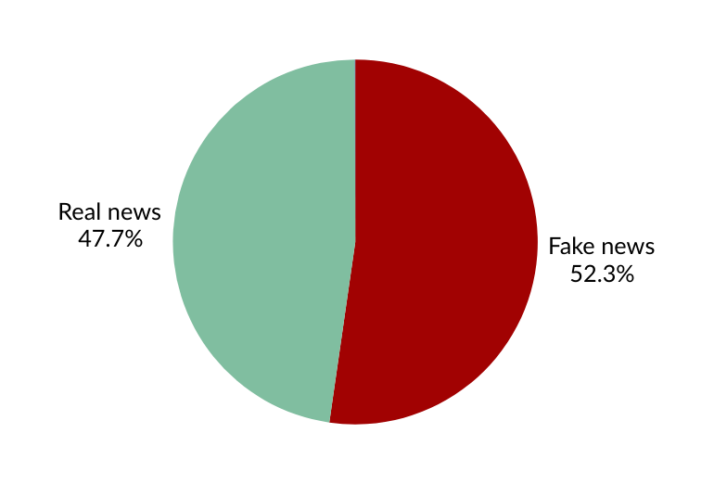

003
1.DATA SET INFORMATION
FAKE AND REAL NEWS DATASET
Fake.csv - 23,481 samples
True.csv - 21,417 samples
Title | Text | Subject | Date
Text | Text | {News, Politics, Others} | Text
Title | Text | Subject | Date
Text | Text | {politicsNews, worldNews} | Text

Slide 6
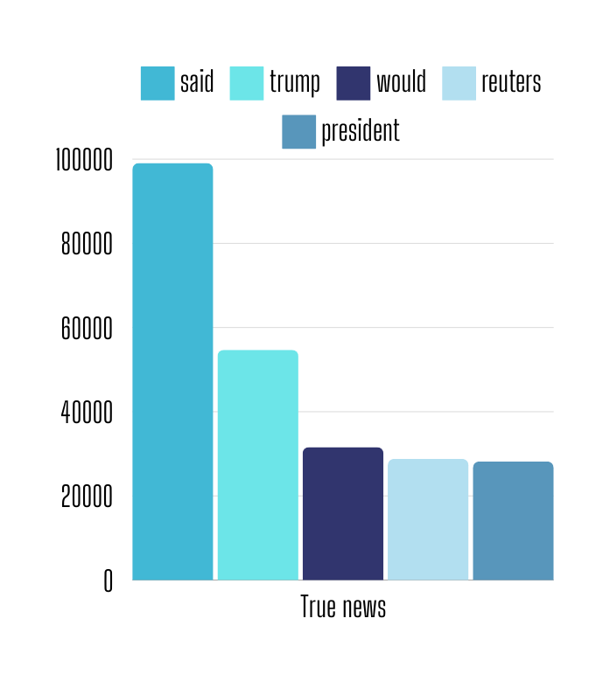
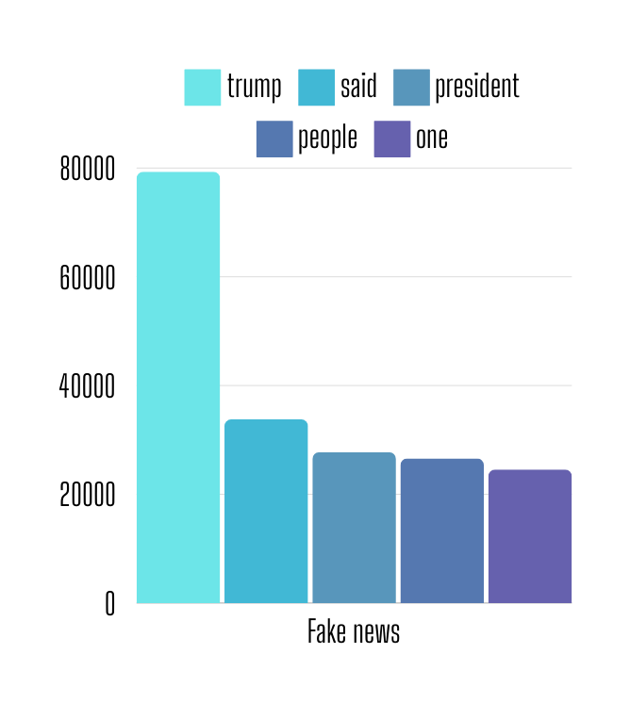
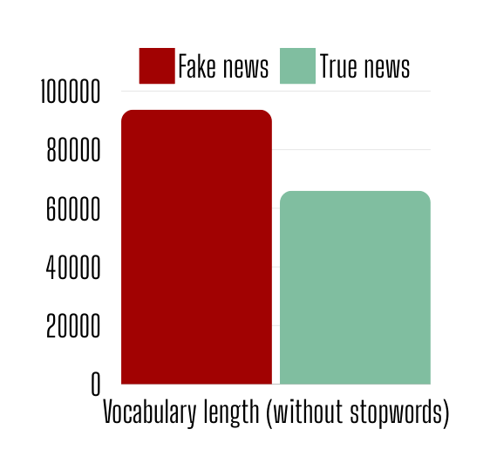
TEXT FIELD
Common words in fake news uncommon in true news
Common words in true news uncommon in fake news
Total Vocabulary length (without stopwords): 121,125
pic: 6,292 vs 3
getty: 4,141 vs 1
gop: 4341 vs 94
4. screen: 1,780 vs 76
5. rep: 1,947 vs 64
6. literally: 24,531 vs 55
beijing: 2,245 vs 65
referendum: 1,721 vs 80
myanmar: 2,838 vs 4
4. rohingya: 2,054 vs 2
5. bangladesh: 1,300 vs 39
6. taiwan: 1,236 vs 89
Will have to shorten the vocabulary when creating BoW vectors!

Slide 7
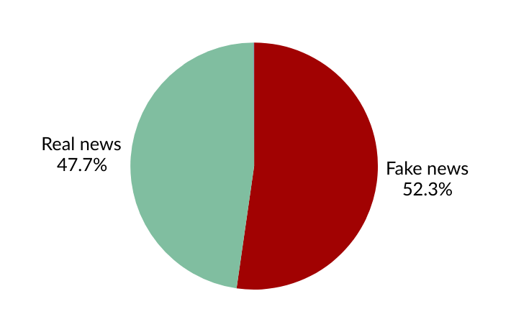

005
2.TRAINING AND TEST SETS
TRAINING SET (80%)
TEST SET (20%)
Total : 35,917 samples
Total : 8,981 samples

Slide 8
006
3.MY APPROACH
Obtain data from input arguments
Download dataset
Divide in train and test dataframes and add labels
Pre-process text
Train model
Test model and compute metrics
Ask user for input and predict label

Slide 9
STEP 4: PRE-PROCESS TEXT
007
Apply function to all df_train[”Text”] and df_test[”Text”]:
def preprocess(text):
lowercase
remove special characters
split in words
remove stopwords (NLTK stopwords set)
if Naive Bayes:
add words to vocabulary set
if Logistic Regression:
add words to word list
df[”Filtered words”] = words

Slide 10
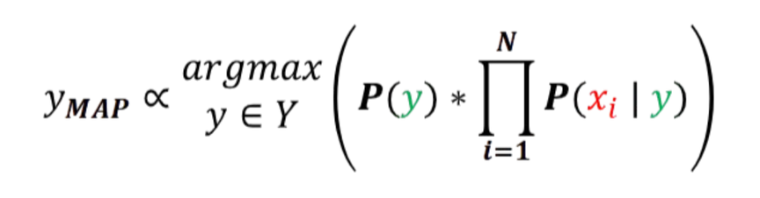


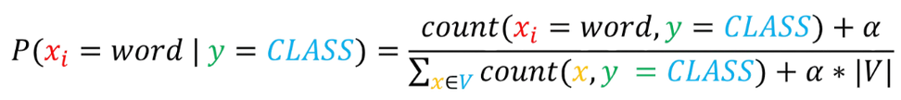
STEP 5A: TRAIN MODEL - NAIVE BAYES
008
def train_NB(df_true_train, df_fake_train):
dict_words_true = {keys: words in df_true_train, values: count of word in df_true_train
dict_words_fake = {keys: words in df_fake_train, values: count of word in df_fake_train}
add missing words from vocabulary in dicts with count = 0
Σcount(xi,y=true) sum( values of dict_words_true)
Σcount(xi,y=fake) sum( values of dict_words_fake)
dict_word_true values = log((dict_words_true values+1)/(Σcount(xi,y=true)+vocab length))
dict_word_fake values = log((dict_words_fake values+1)/(Σcount(xi,y=fake)+vocab length))
log(P(y=true) = log(length df_train_true / length df_train)
log(P(y=fake) = log(length df_train_fake / length df_train)
Return dict_word_true, dict_word_fake, log(P(y=true)), log(P(y=fake)),normalized_exp_pfake
Add-α smoothing ( α=1)

Slide 11
STEP 6A: TEST MODEL AND COMPUTE METRICS - NAIVE BAYES
009
Apply function to all df_test[”Filtered words”]
def test_NB(dict_words_true, dict_words_fake, prob_true, prob_fake, words):
word_counter = {keys: words of text, values: occurences of word}
P(y=true/text) = log(P(y=true))
P(y=fake/text) = log(P(y=fake))
for word in words:
if word is in dict_words_true:
P(y=true/text) += word_counter[word] * dict_words_true[word]
if word is in dict_words_fake:
P(y=fake/text) += word_counter[word] * dict_words_fake[word]
if P(y=true/text) > P(y=fake/text) prediction = true, else prediction = false
normalized_exp_pfake = normalized by maxlogp and convert back to exp
return prediction, probabilities
Compute requested metrics using scikit-learn metrics module

Slide 12
STEP 5B: TRAIN MODEL - LOGISTIC REGRESSION
010
reduced vocabulary = words that appear > 30 times in texts
vocabulary_dict = {key: words, values: index of word in BoW vector}
Apply function to all df_train[”Filtered Words”] and df_test[”Filtered Words”]
def create_bow_vector(words, vocabulary):
BoW = [1] * reduced vocabulary length
for word in words:
index = vocabulary_dict[word]
BoW[index_word] + 1
Assign results to df_train[”Bow Vector”] and df_test[”Bow Vector”]
# scikit-learn implementation
model = LogisticRegression.fit(BoW vectors train, labels)

Slide 13
STEP 6B: TEST MODEL AND COMPUTE METRICS - logistic regression
011
predictions = LogisticRegression.predict(BoW vectors test)
Compute requested metrics using scikit-learn metrics module

Slide 14
STEP 7: ASK USER FOR INPUT AND PREDICT LABEL
012
sentence = user input
lowercase sentence
remove special characters
split sentence in words
remove stopwords
if Naive Bayes:
test_NB(dict_words_true, dict_words_fake, prob_true, prob_fake, words)
# ignores OOV words
if Logistic Regression:
BoW = create_bow_vector(words, vocabulary) #ignores OOV words
LogisticRegression.predict(BoW)
print(prediction)
ask user for new input
repeat until user selects “N”

Slide 15
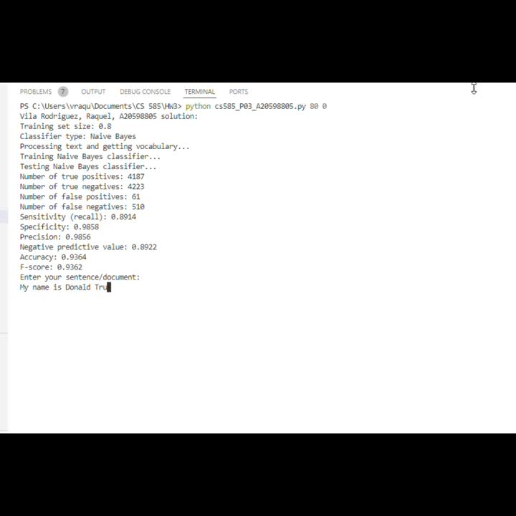
013
DEMO

Slide 16
014
4.EVALUATION
PREDICTION
PREDICTION
 | True | Fake
True | 4225 | 59 | Recall = 0.8972
Fake | 483 | 4214 | Specificity = 0.9862
 | Precision = 0.9862 | NPV = 0.8972 | Accuracy = 0.9397
 | True | Fake
True | 4268 | 16 | Recall = 0.9891
Fake | 51 | 4646 | Specificity = 0.9963
 | Precision = 0.9966 | NPV = 0.9882 | Accuracy = 0.9925
NAIVE BAYES
LOGISTIC REGRESSION
TRUTH
TRUTH
F-score = 0.9396
F-score = 0.9928

Slide 17
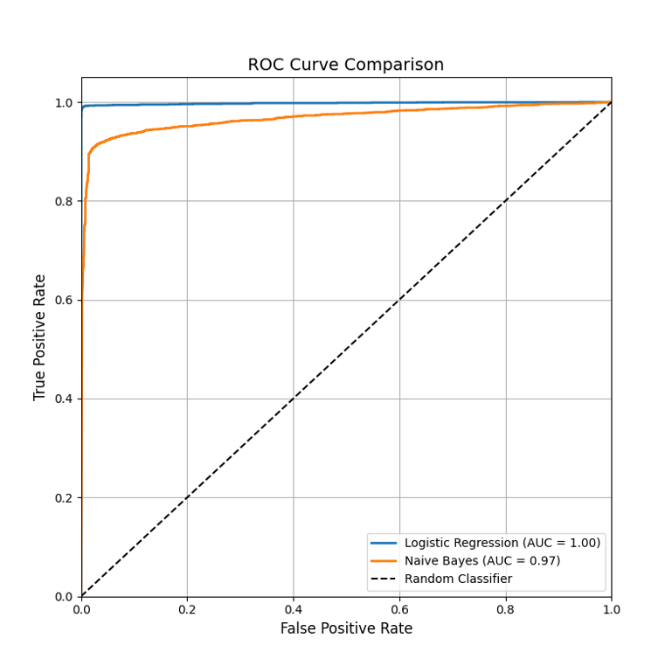
015
Both classifiers show very good performance
The logistic regression classifier is almost perfect

Slide 18


017
5.SUMMARY
Both classifiers are able to classify the text correctly in most cases
The way of creating the BoW vectors is not the most efficient and takes a lot of time (and memory)
Vocabulary could be further reduced by taking into account words that appear with similar (high) frequency in both true and fake news (e.g: trump, said, president...)
We could also attempt to classify only based on the title, which would reduce computation times largely

Slide 19
017
THANK YOU!
For any questions, my email is: rvilarodriguez@hawk.iit.edu

